Slide 1

DIGITAL PORTFOLIO
STUDENT NAME: PAVITHRA. P
REGISTER NO AND NMID: 222403842/asum293222403842
DEPARTMENT: COMPUTER SCIENCE
COLLEGE: COLLEGE/ UNIVERSITY
Notes:
PAVITHRA. P

Slide 2

DIGITAL FORTPOLIO

Slide 3


AGENDA
Problem Statement
Project Overview
End Users
Tools and Technologies
Portfolio design and Layout
Features and Functionality
Results and Screenshots
Conclusion
Github Link
3/21/2024 Annual Review

Slide 4

PROBLEM STATEMENT
--- Content A clear description of the issue to be solved. Helps to focus on the main problem without distractions. Defines the scope and objectives of the solution. Acts as the foundation for all further steps in problem solving.
Notes:
--- Content A clear description of the issue to be solved. Helps to focus on the main problem without distractions. Defines the scope and objectives of the solution. Acts as the foundation for all further steps in problem solving.

Slide 5

PROJECT OVERVIEW
Introduction: Brief background of the project. Objective: Main purpose and goals. Scope: Key areas covered in the project. Methodology: Approach or process followed.
Notes:
PROJECT OVERVIEW

Slide 6


END USERS
Individuals, groups, or organizations who will directly use the product/service. Their needs, preferences, and challenges shape the design and functionality. Provide valuable feedback to improve performance and usability.

Slide 7


TOOLS AND TECHNIQUES
Tools Software, platforms, or applications used to execute the project. Ensure efficiency, accuracy, and consistency in outcomes. Examples: MS Excel, PowerPoint, Project Management Tools, Data Analysis Software. Techniques Methods, processes, or best practices applied during project execution. Help in problem-solving, decision-making, and performance improvement. Examples: SWOT Analysis, Surveys, Brainstorming, Agile Methodology.

Slide 8

PORTFOLIO DISIGN AND LAYOUT
Clean & Professional – Consistent fonts, colors, and spacing Well-Structured – Clear sections (About, Skills, Projects, Contact) Balanced Layout – Text + visuals with enough white space User-Friendly – Easy to read, logical flow Impactful – Highlights strengths & achievements effectively

Slide 9


FEATURES AND FUNCTIONALITY
Core Features – Key elements that define the portfolio (About, Skills, Projects, Contact). Interactivity – Clickable navigation, smooth transitions, and user-friendly flow. Responsiveness – Works well on both desktop and mobile devices. Customization – Flexible design for personal branding and unique style. Performance – Fast loading, optimized visuals, and easy accessibility.
9

Slide 10
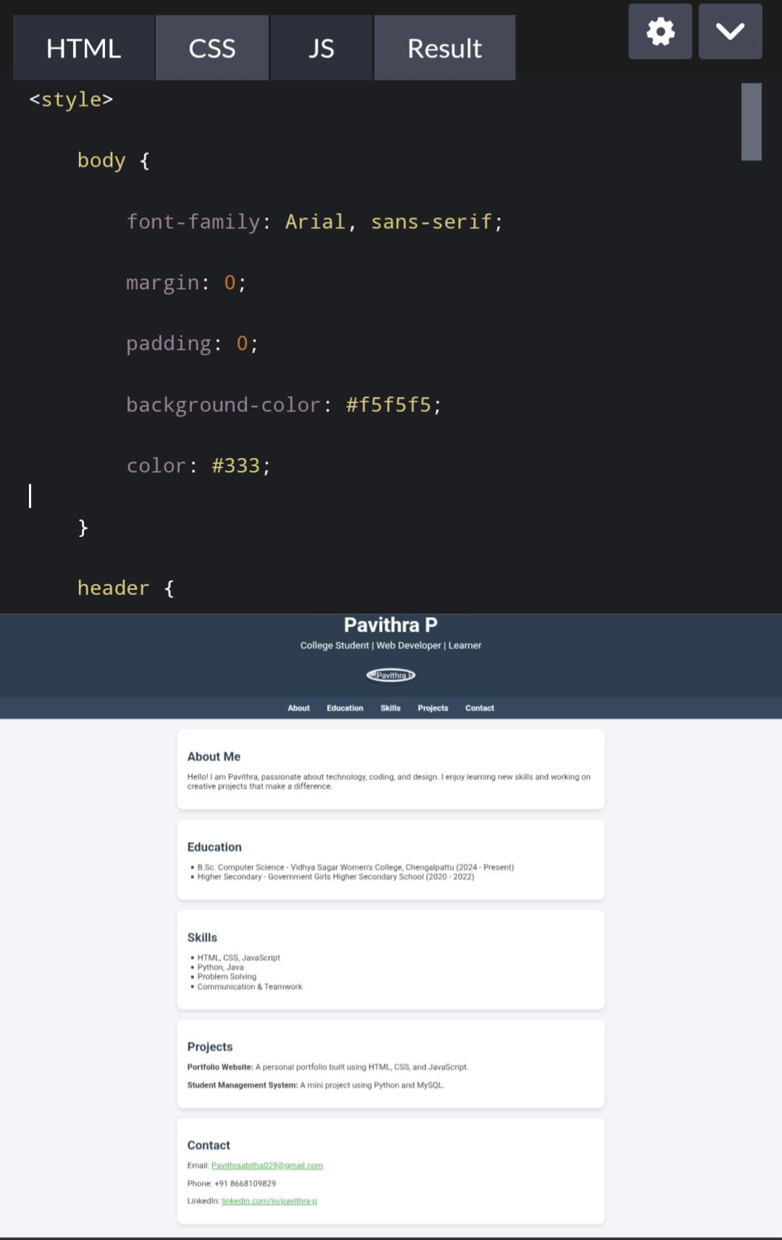
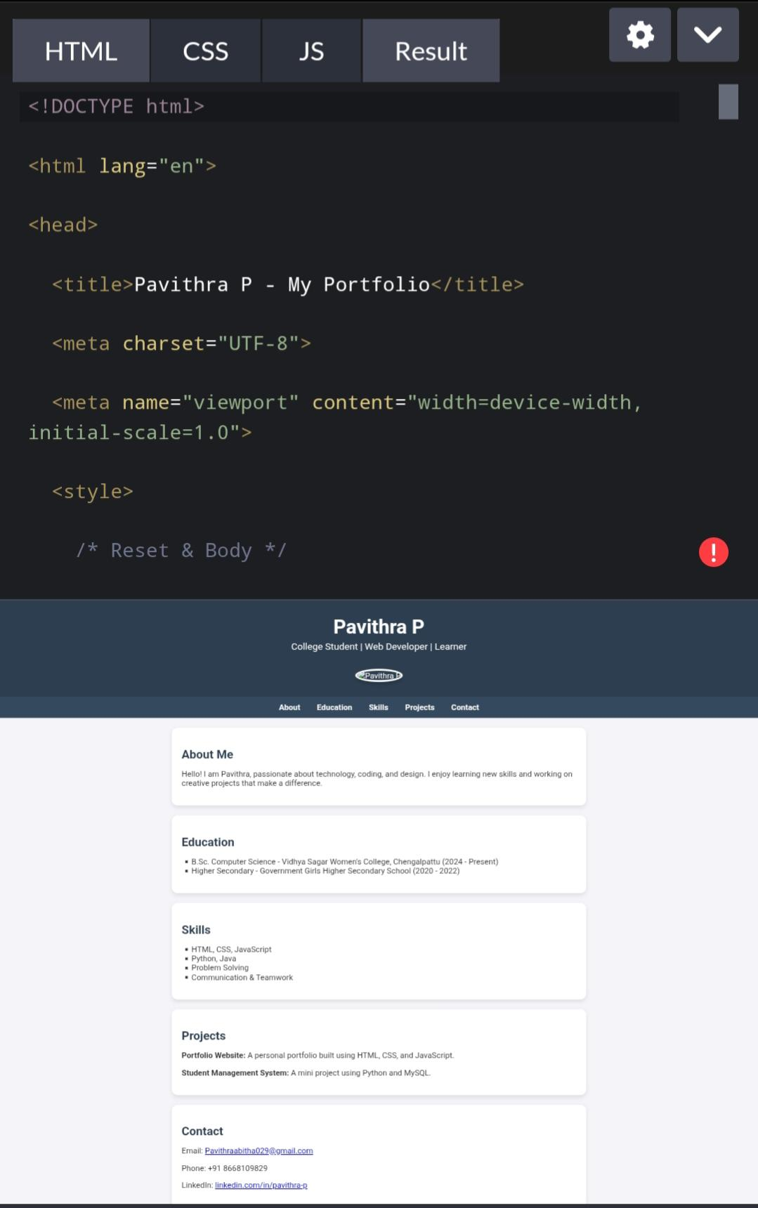
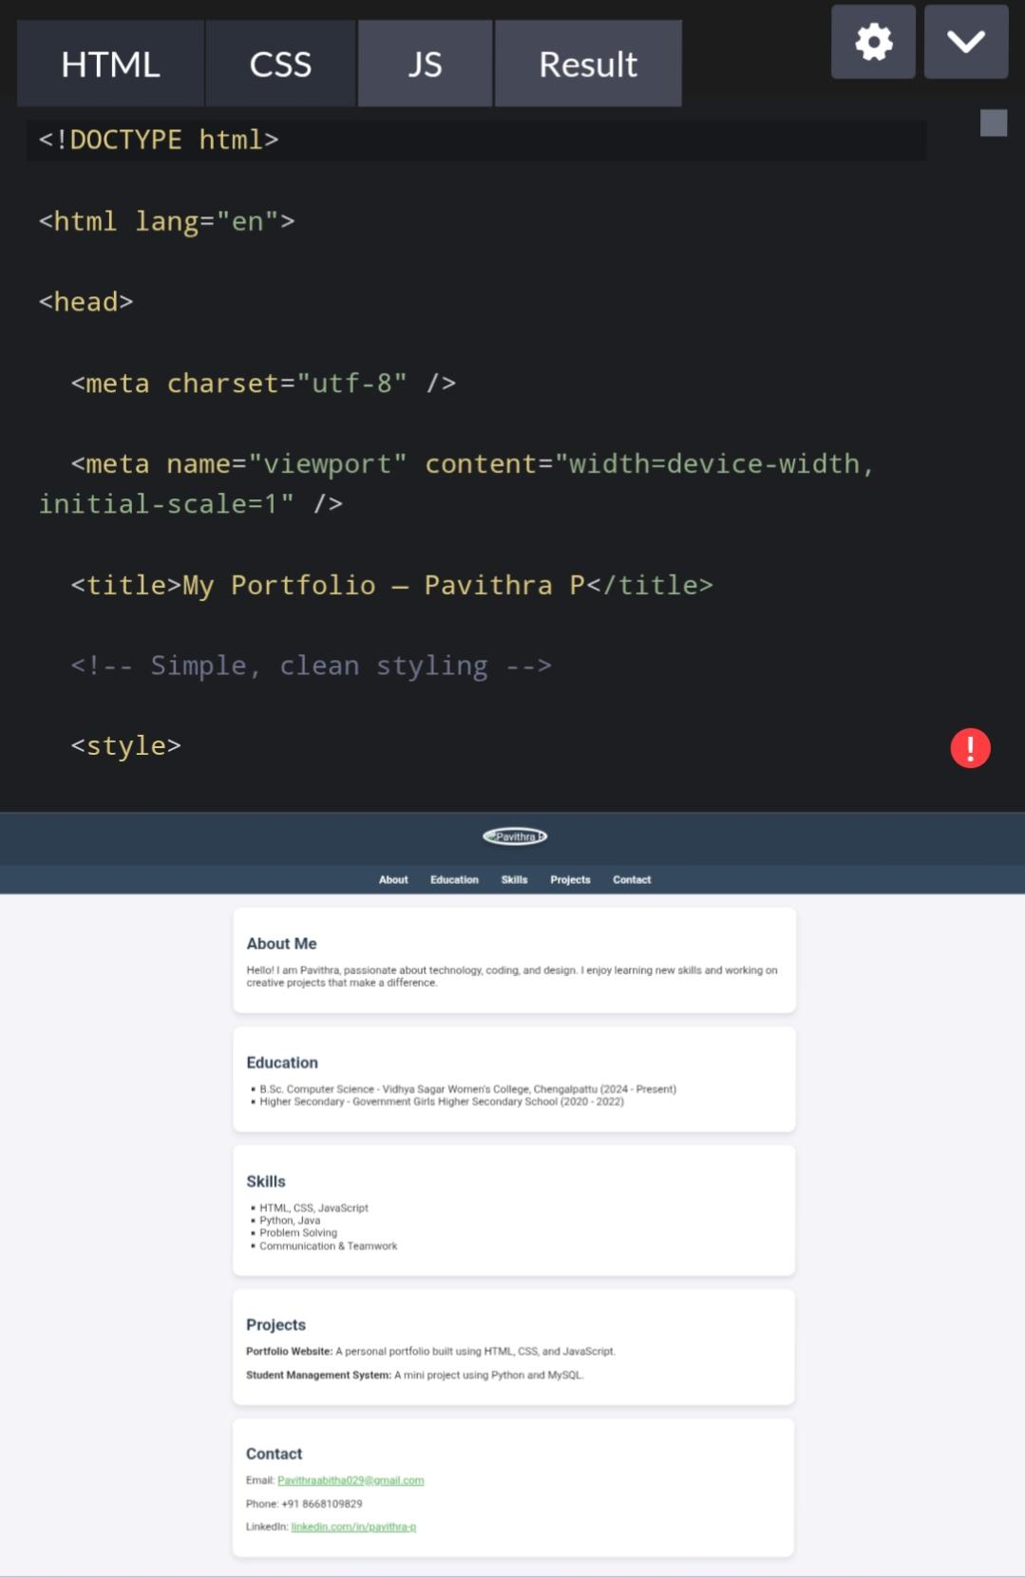
REASULTS AND SCREENSHOT
ResultsProject goals achieved successfully.Improved efficiency and accuracy.ScreenshotShows the working model/interface.Acts as proof of implementation.

Slide 11

CONCLUSION
Summarizes the overall project outcomes and achievements. Confirms that the objectives and goals were successfully met. Highlights the key benefits and improvements delivered.
3/21/2024 Annual Review
11

Slide 12

GITHUP LINK
Access the full project source code. View implementation details and documentation. Explore contributions and updates. 🔗 GitHub Repository: [https://skills.yourlearning.ibm.com/activity/PLAN-741582ED6C44
12

